Slide 1


Slide 2
Purpose & Learning Objectives
Purpose of These Instructions
To guide beginners through creating an interactive data visualization dashboard using Tableau Public
To help users confidently explore, analyze, and share data visually
By the end of this tutorial, you will be able to:
Import a dataset into Tableau Public
Create basic charts (bar, line, map, etc.)
Combine charts into a dashboard
Add filters and interactivity
Publish and share a dashboard publicly

Slide 3
Audience & Prerequisites
Intended Audience
Beginners and students with little to no experience using Tableau
Novice data analysts and data science students
Prerequisites
A computer with internet access
Tableau Public installed (free)
A basic dataset (CSV or Excel file)
No prior Tableau dashboard experience required

Slide 4
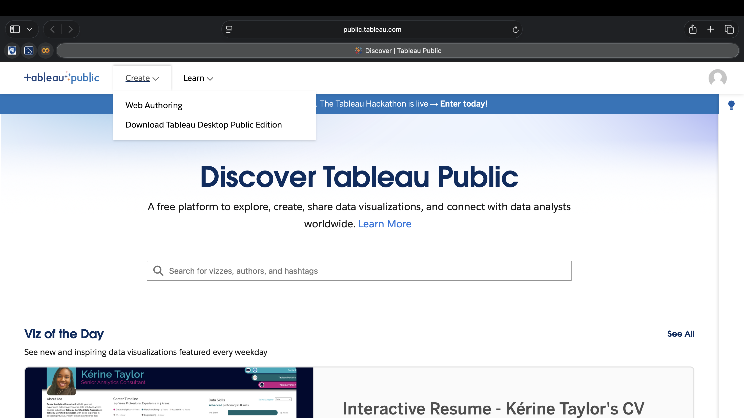
Tools & Materials Needed
Tableau Public (free desktop version)
Dataset file (CSV or Excel with column headers)
Stable internet connection
Computer with at least 4 GB RAM (8 GB recommended)
Tableau Public account (for publishing)

Slide 5

Warnings & Important Notes
Dashboards published to Tableau Public are visible to everyone
Do not upload sensitive, private, or proprietary data
Save your work frequently to avoid data loss
Tableau Public requires an internet connection to publish dashboards
Some features may differ from Tableau Desktop (paid version)

Slide 6
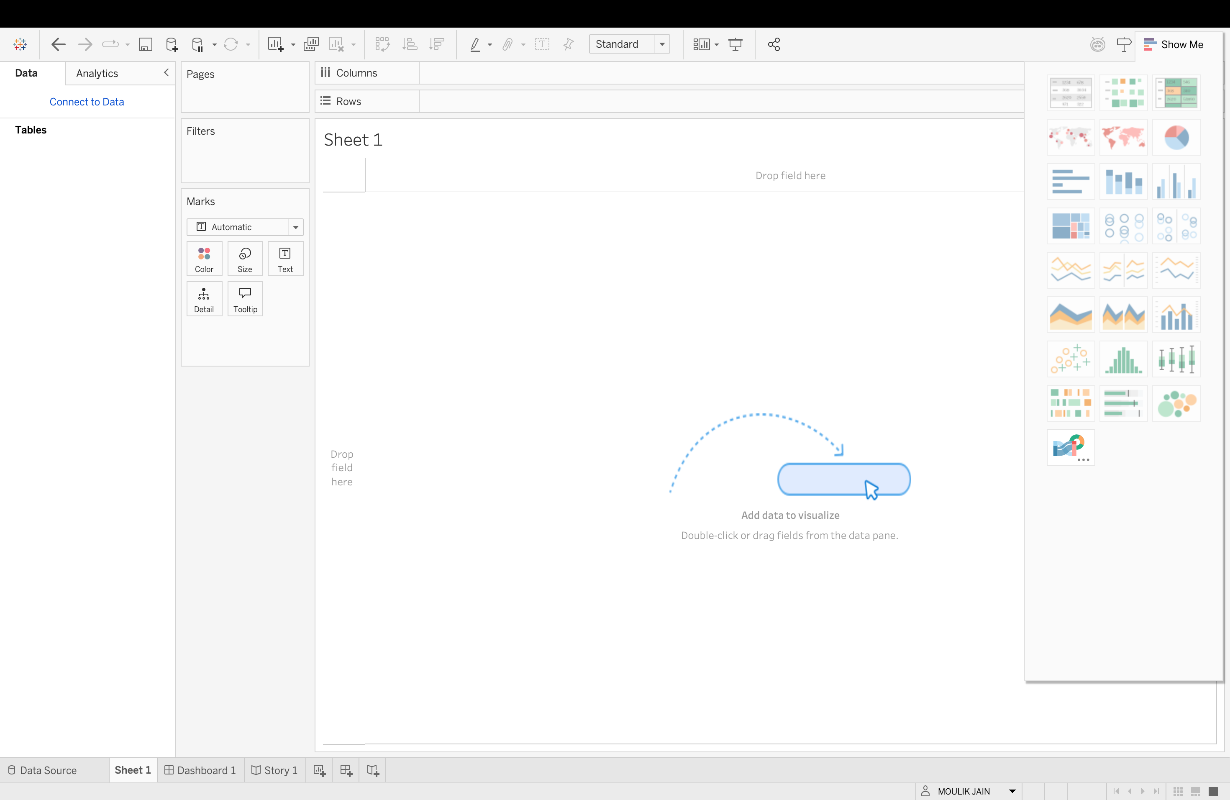
Dashboard Creation Workflow
Open Tableau Public and connect to data
Explore and prepare the dataset
Create individual charts (worksheets)
Build a dashboard
Add filters and interactivity
Publish and share the dashboard

Slide 7
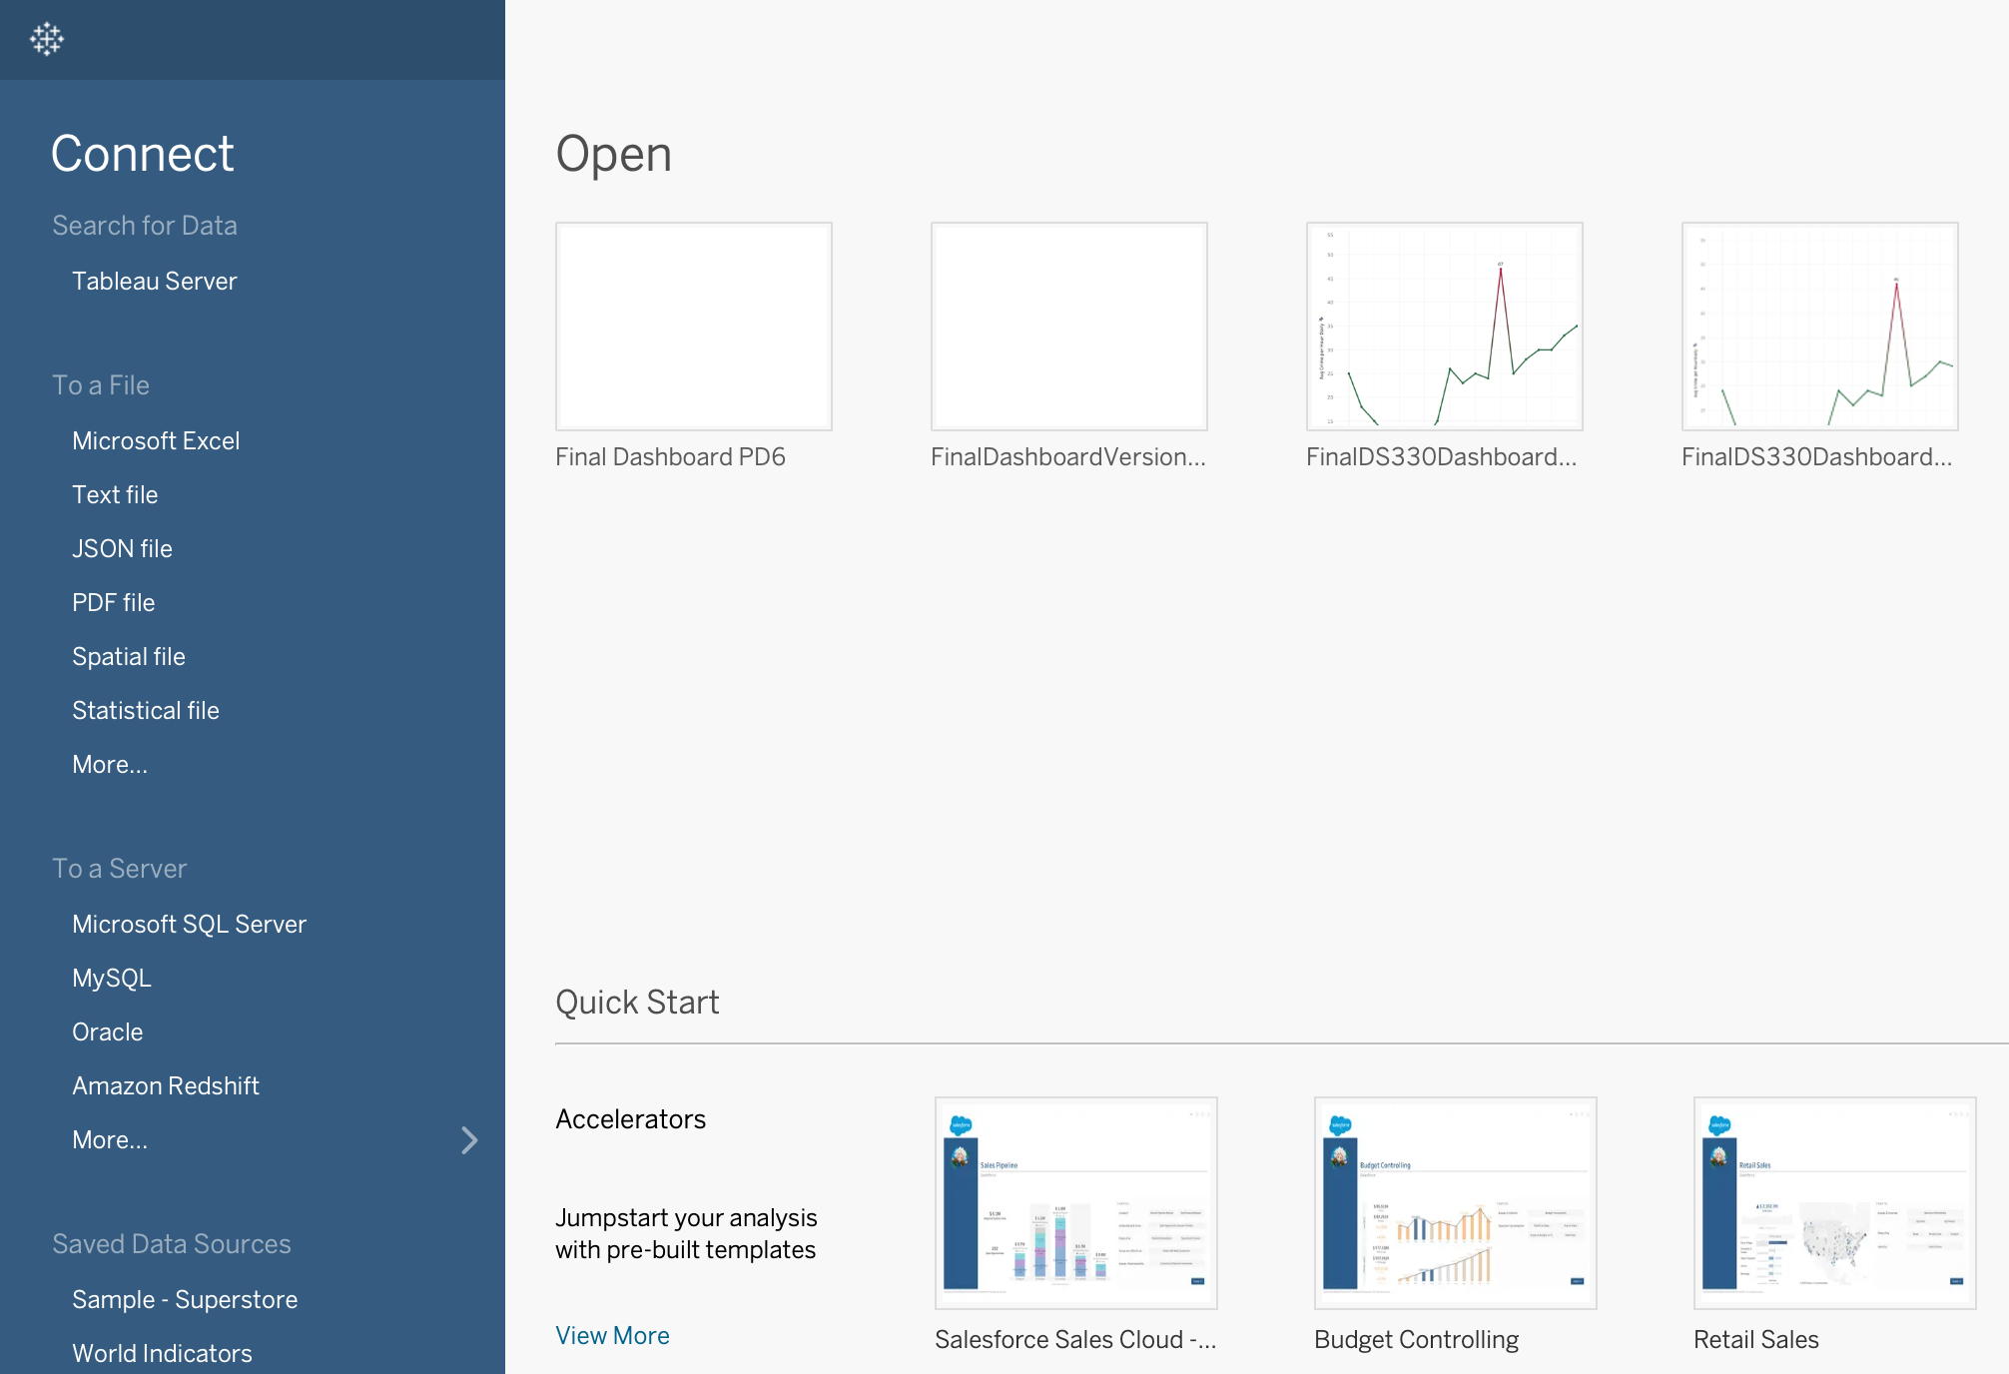
Step 1: Open Tableau Public and Connect to Data
Step 1: Open Tableau Public
Launch Tableau Public on your computer
Sign in to your Tableau Public account
Connect to a Data Source
Click Text File (for CSV) or Microsoft Excel
Locate and open your dataset file
Verify that fields appear correctly in the Data pane
Note: Tableau automatically detects data types, but you should confirm dimensions and measures before proceeding.
Figure 1. Tableau Public start screen showing data connection options.

Slide 8
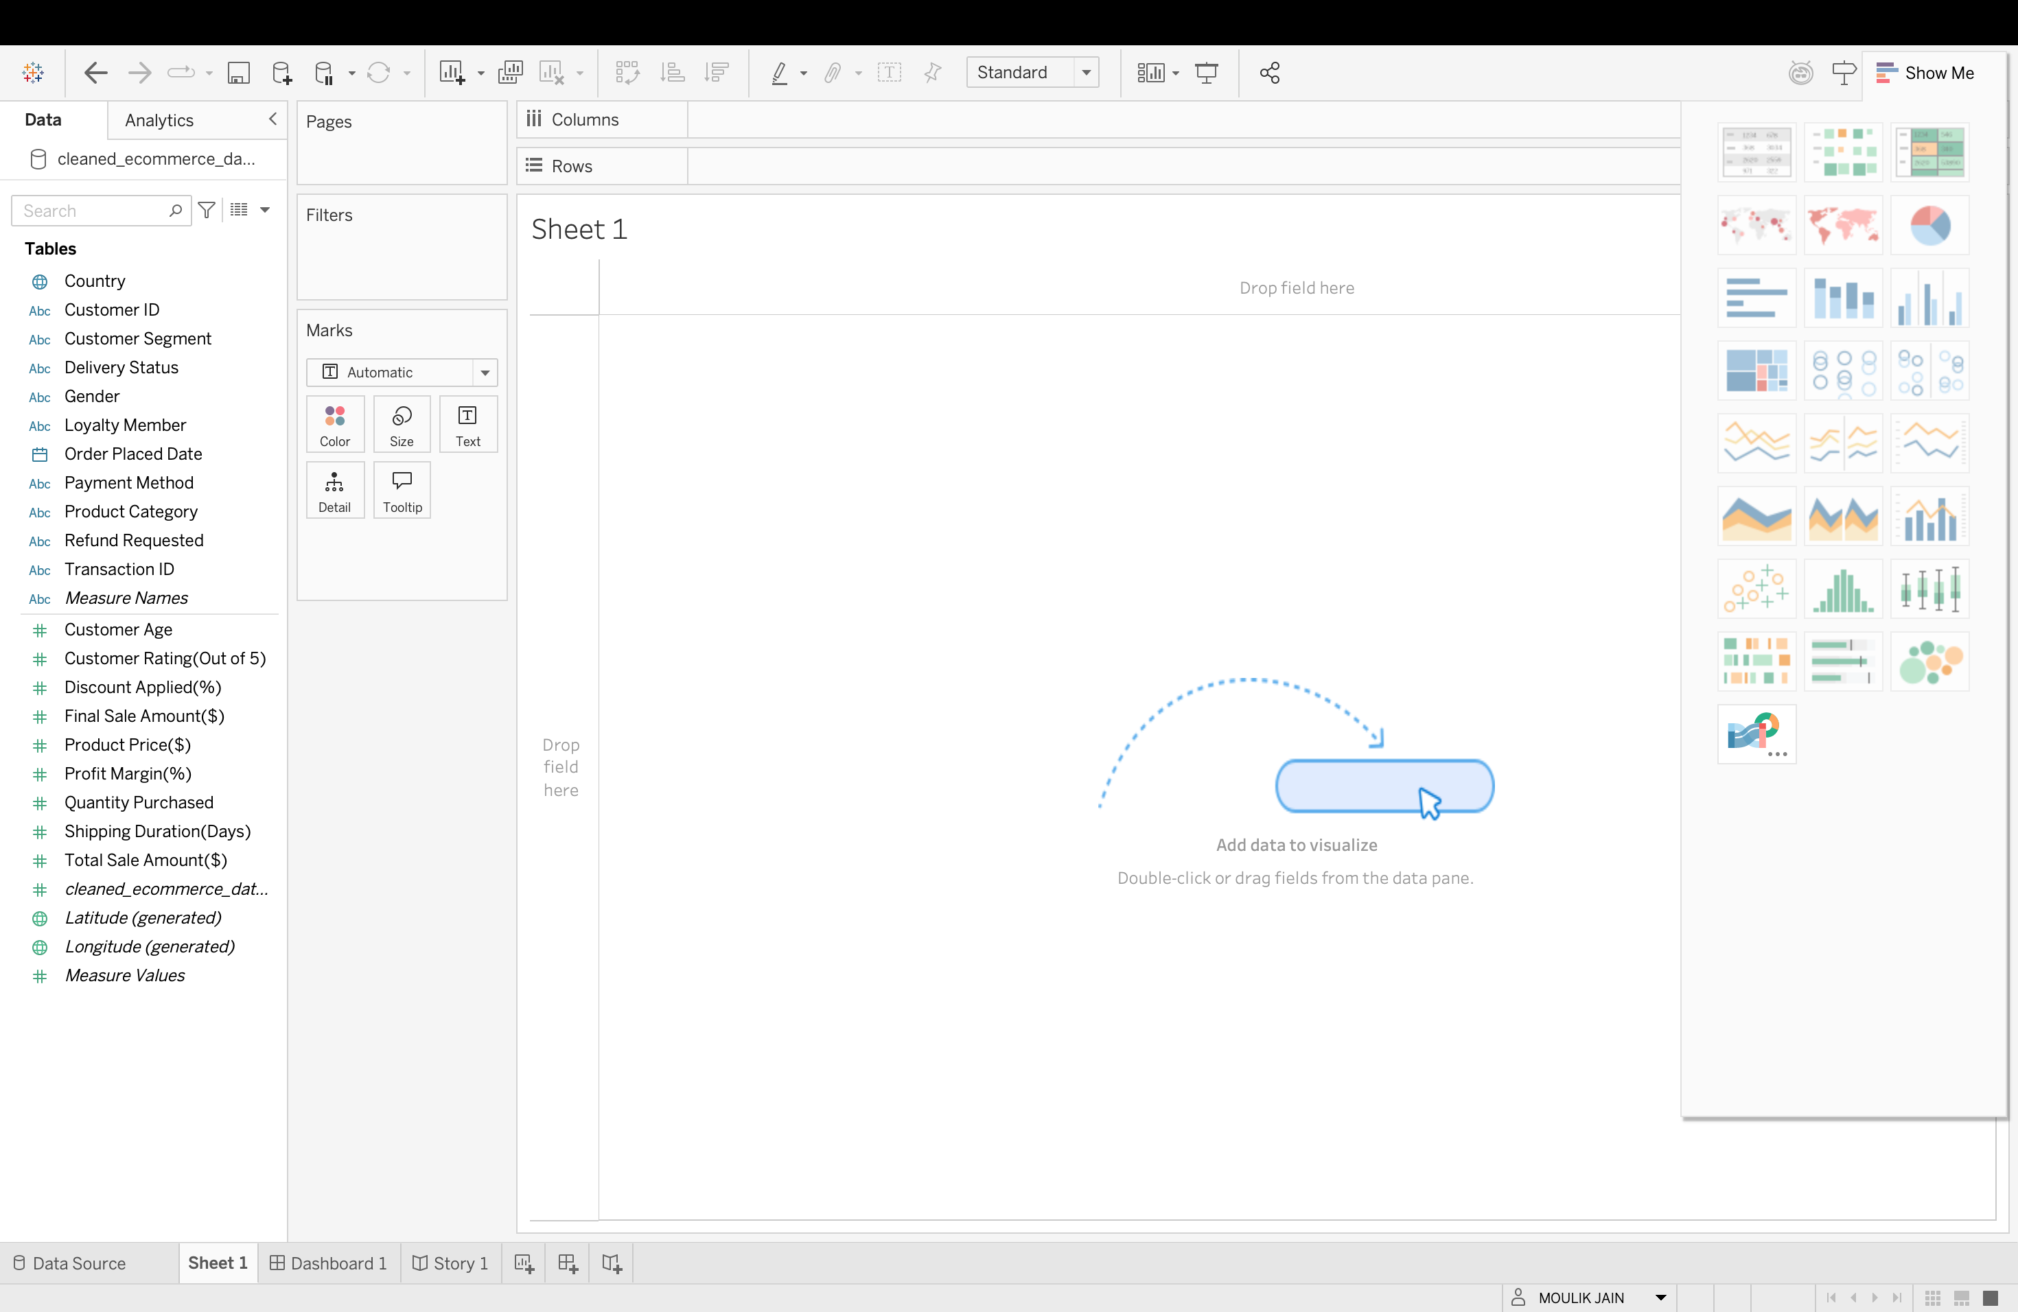
Step 2: Understand the Tableau Workspace
Step 2: Understand the Tableau Workspace
Key Interface Areas:
Data Pane: Lists available dimensions and measures
Rows and Columns Shelves: Control chart structure
Marks Card: Adjust color, size, labels, and tooltips
Filters Shelf: Limit the data displayed
Show Me Panel: Suggests chart types
Note: Understanding where tools are located will make chart creation easier in later steps.
MARKS CARD
DATA PANE
SHOW ME PANEL
Figure 2. Tableau worksheet interface highlighting key workspace components

Slide 9
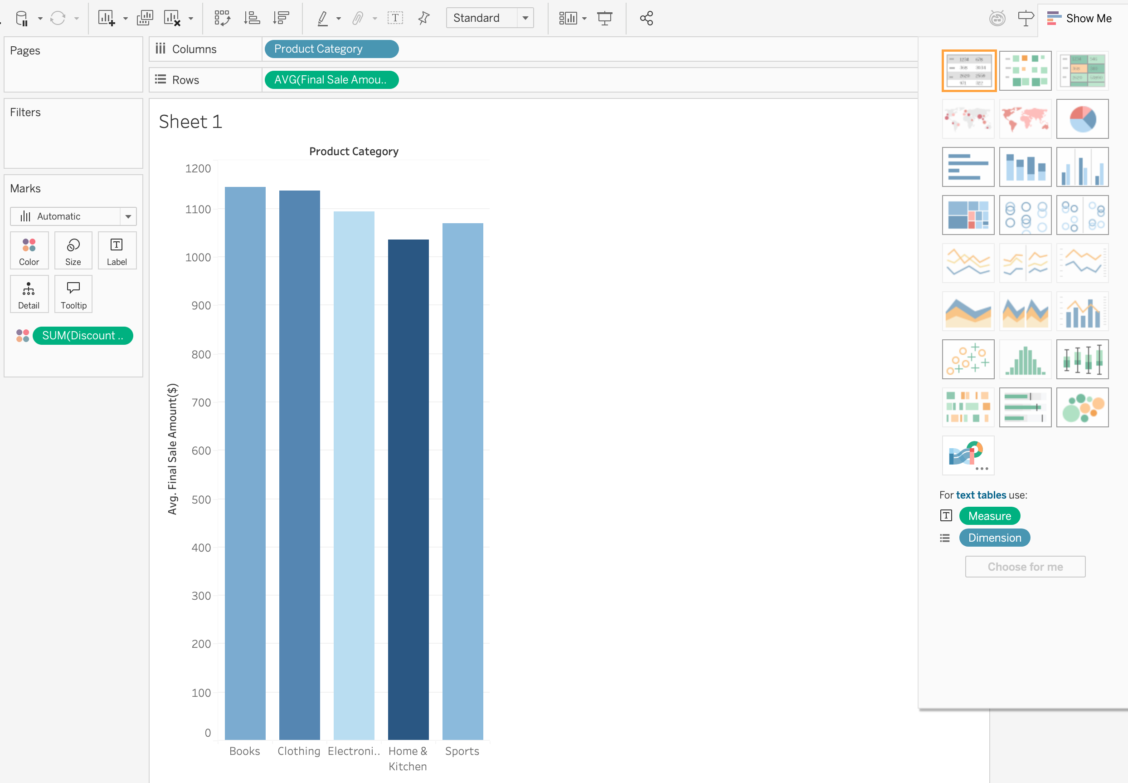
Step 3: Create Your First Chart (Worksheet)
Step 3: Create a Basic Chart
Drag a dimension (e.g., Category) to Columns
Drag a measure (e.g., Sales) to Rows
Use the Show Me panel to select a chart type
Use the Marks card to refine colors, labels, and tooltips
Note: Start with simple charts before adding interactivity.

Slide 10
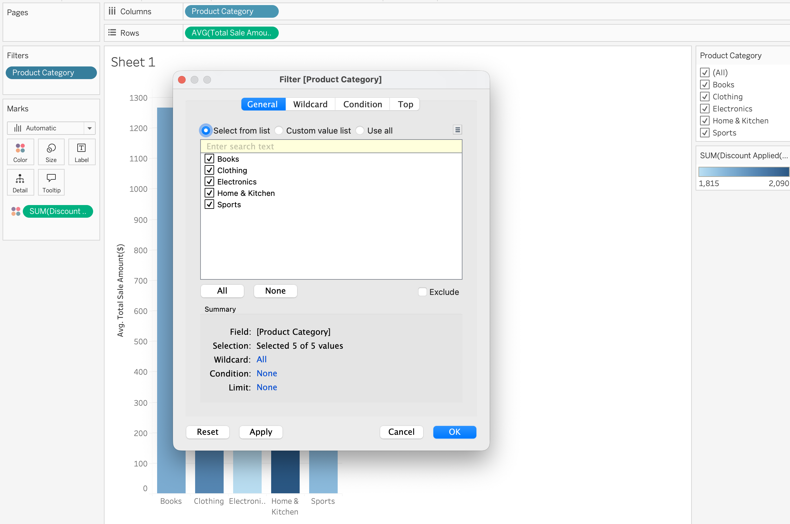
Step 4: Add Filters and Interactivity
Step 4: Add Filters
Drag a field (e.g., Category or Region) to the Filters shelf
Choose filter values and click OK
Right-click the filter and select Show Filter
Add Interactivity
Customize the filter type (dropdown, slider, checkbox)
Apply filters to all worksheets if needed
Test interactivity by clicking and adjusting filters
Note: Filters allow users to explore data dynamically without changing the underlying chart.

Slide 11
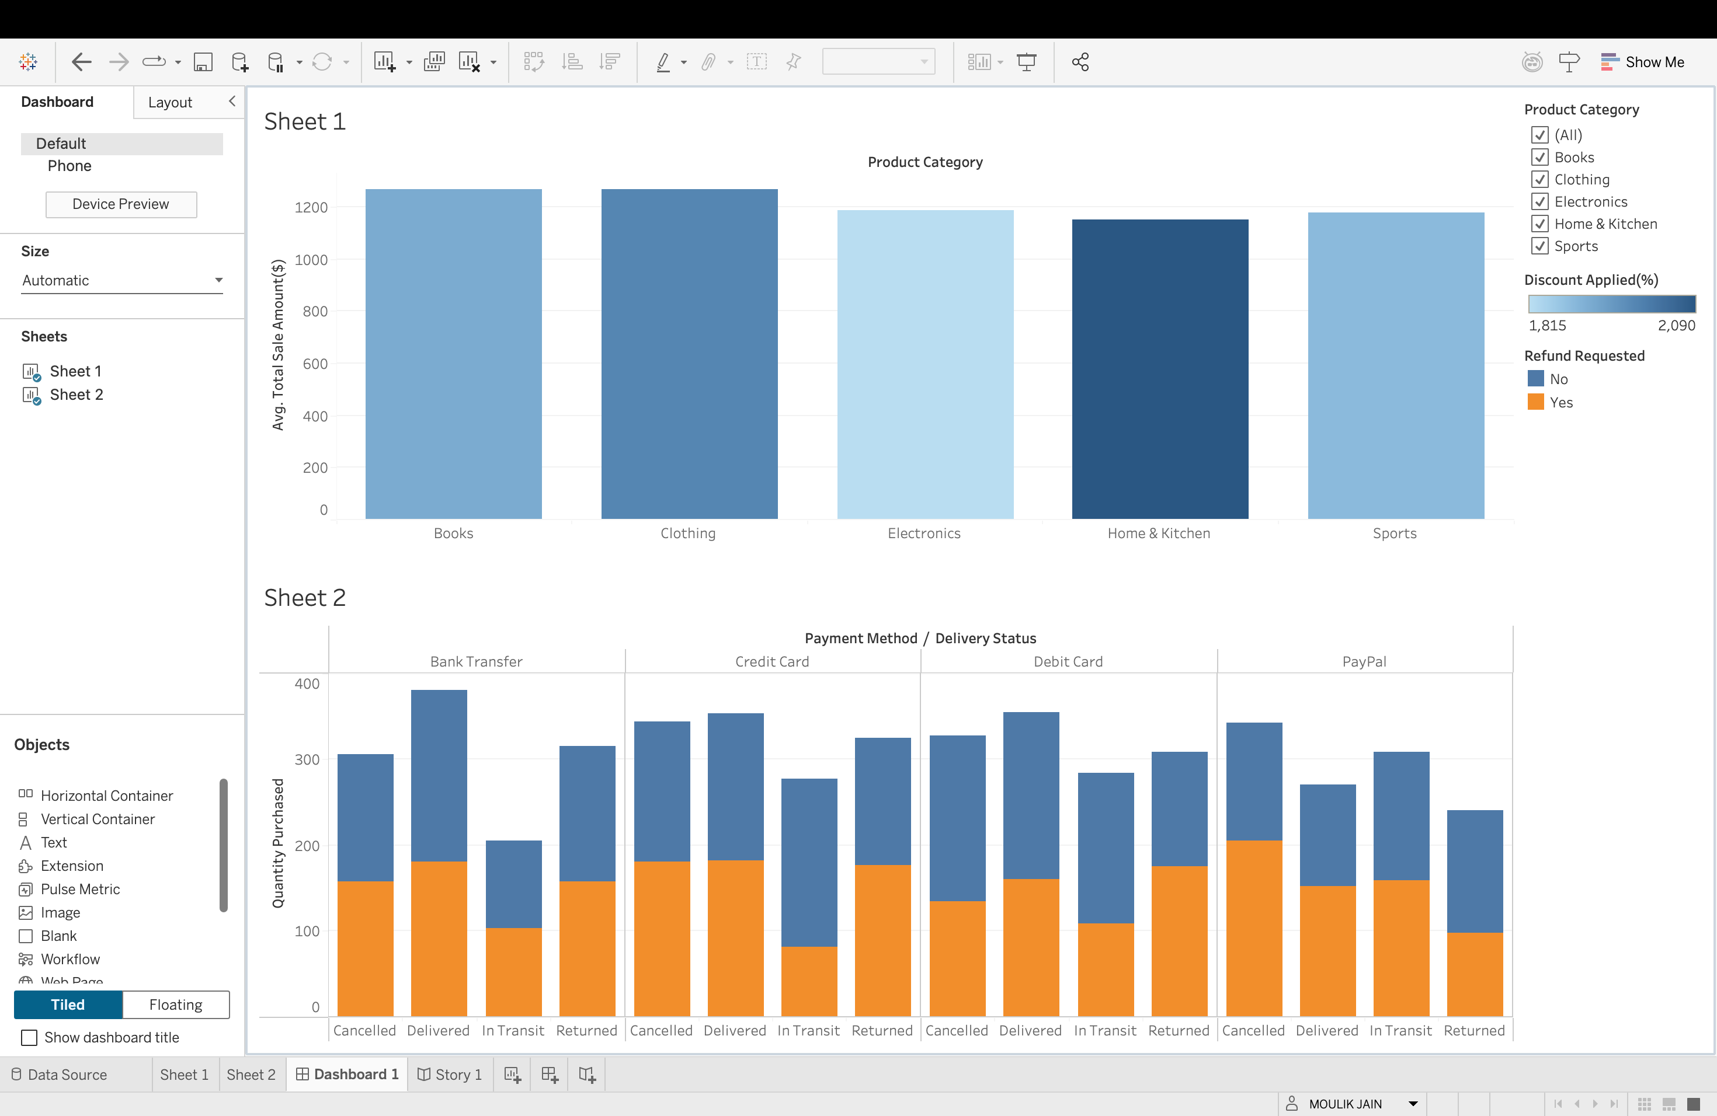
Step 5: Build the Dashboard
Step 5: Combine Worksheets into a Dashboard
Click New Dashboard at the bottom of Tableau
Set the dashboard Size (Automatic or Fixed)
Drag worksheets from the Sheets panel into the canvas
Arrange charts using horizontal/vertical containers
Add titles and spacing for clarity
Note: Dashboards allow multiple views to be analyzed together.

Slide 12
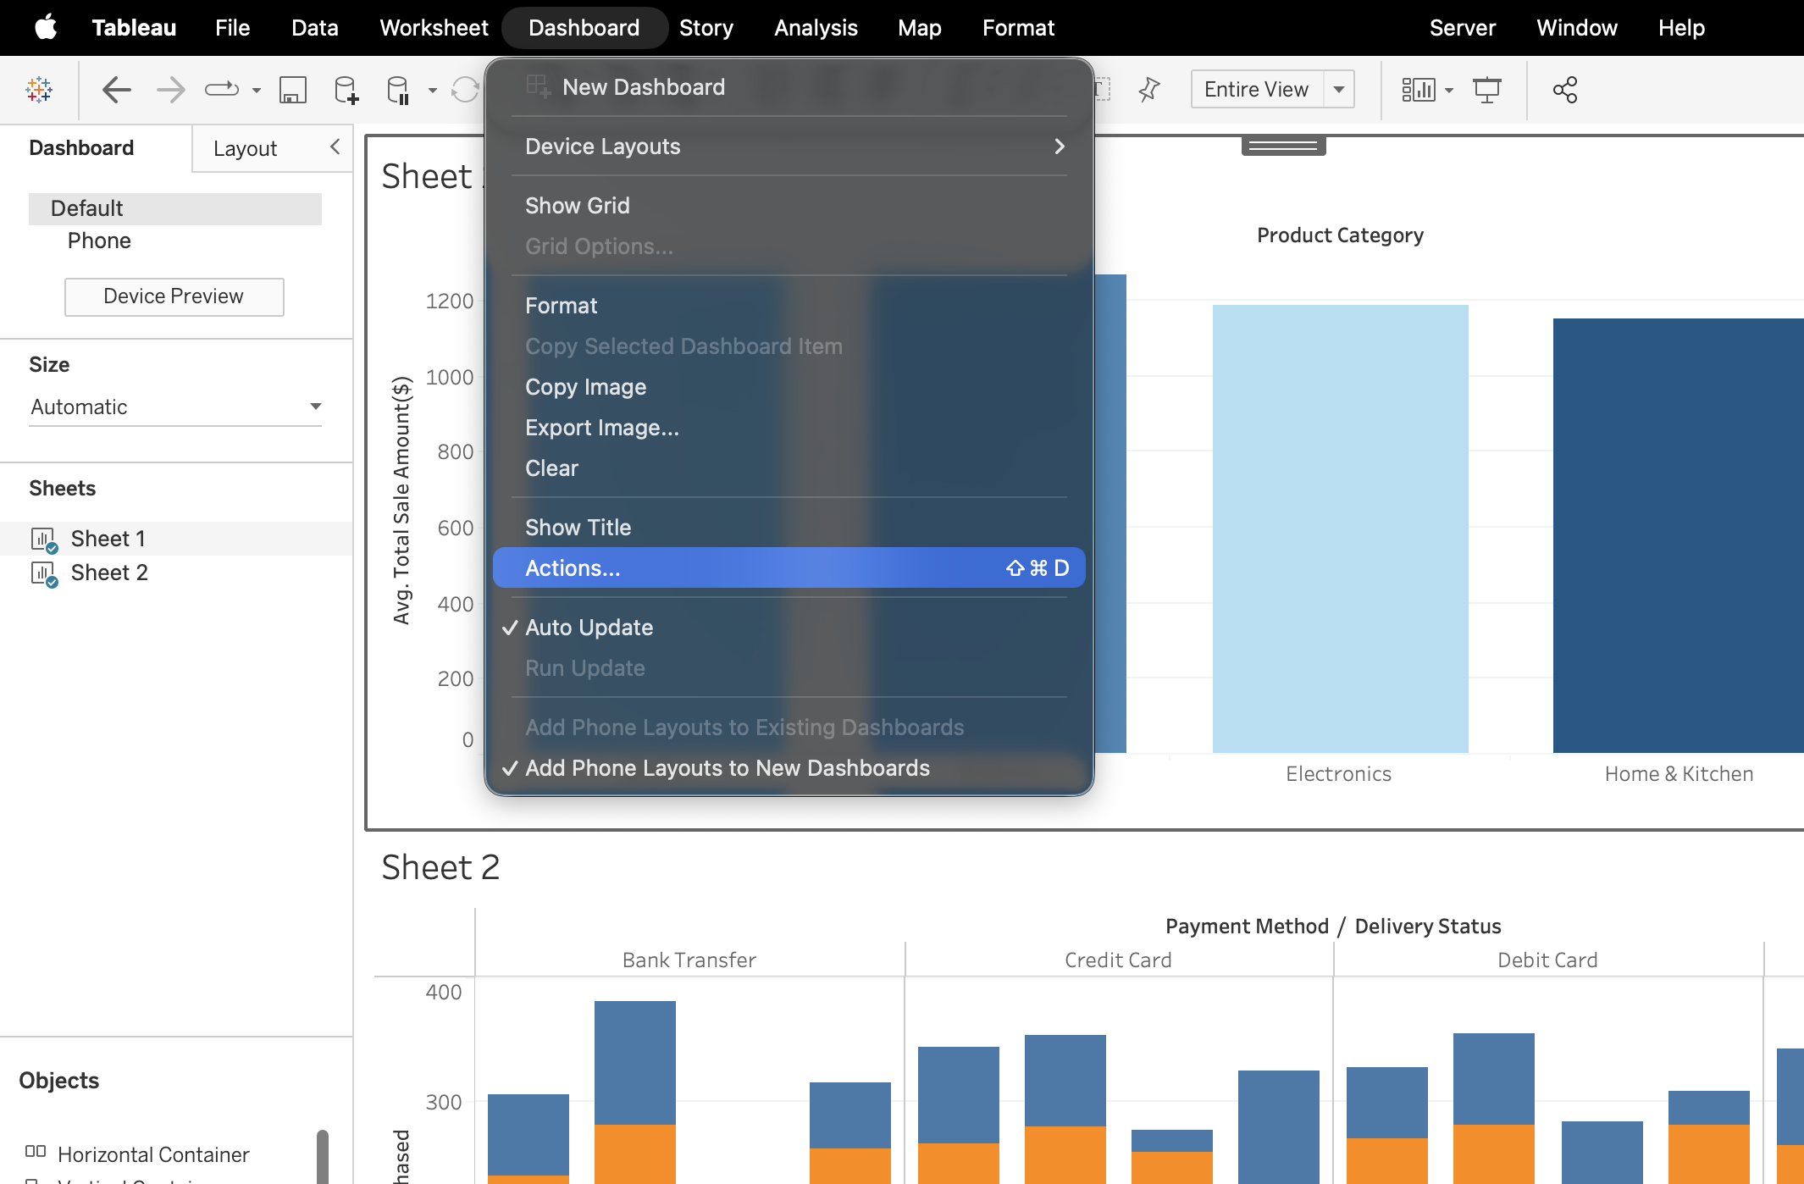
Step 6: Add Dashboard Actions
Add Interactivity with Dashboard Actions
Click Dashboard → Actions
Choose an action type:
Filter (most common)
Highlight
URL
Select source and target sheets
Test interactions by clicking chart elements
Tip: Filter actions let users click one chart to update others.

Slide 13
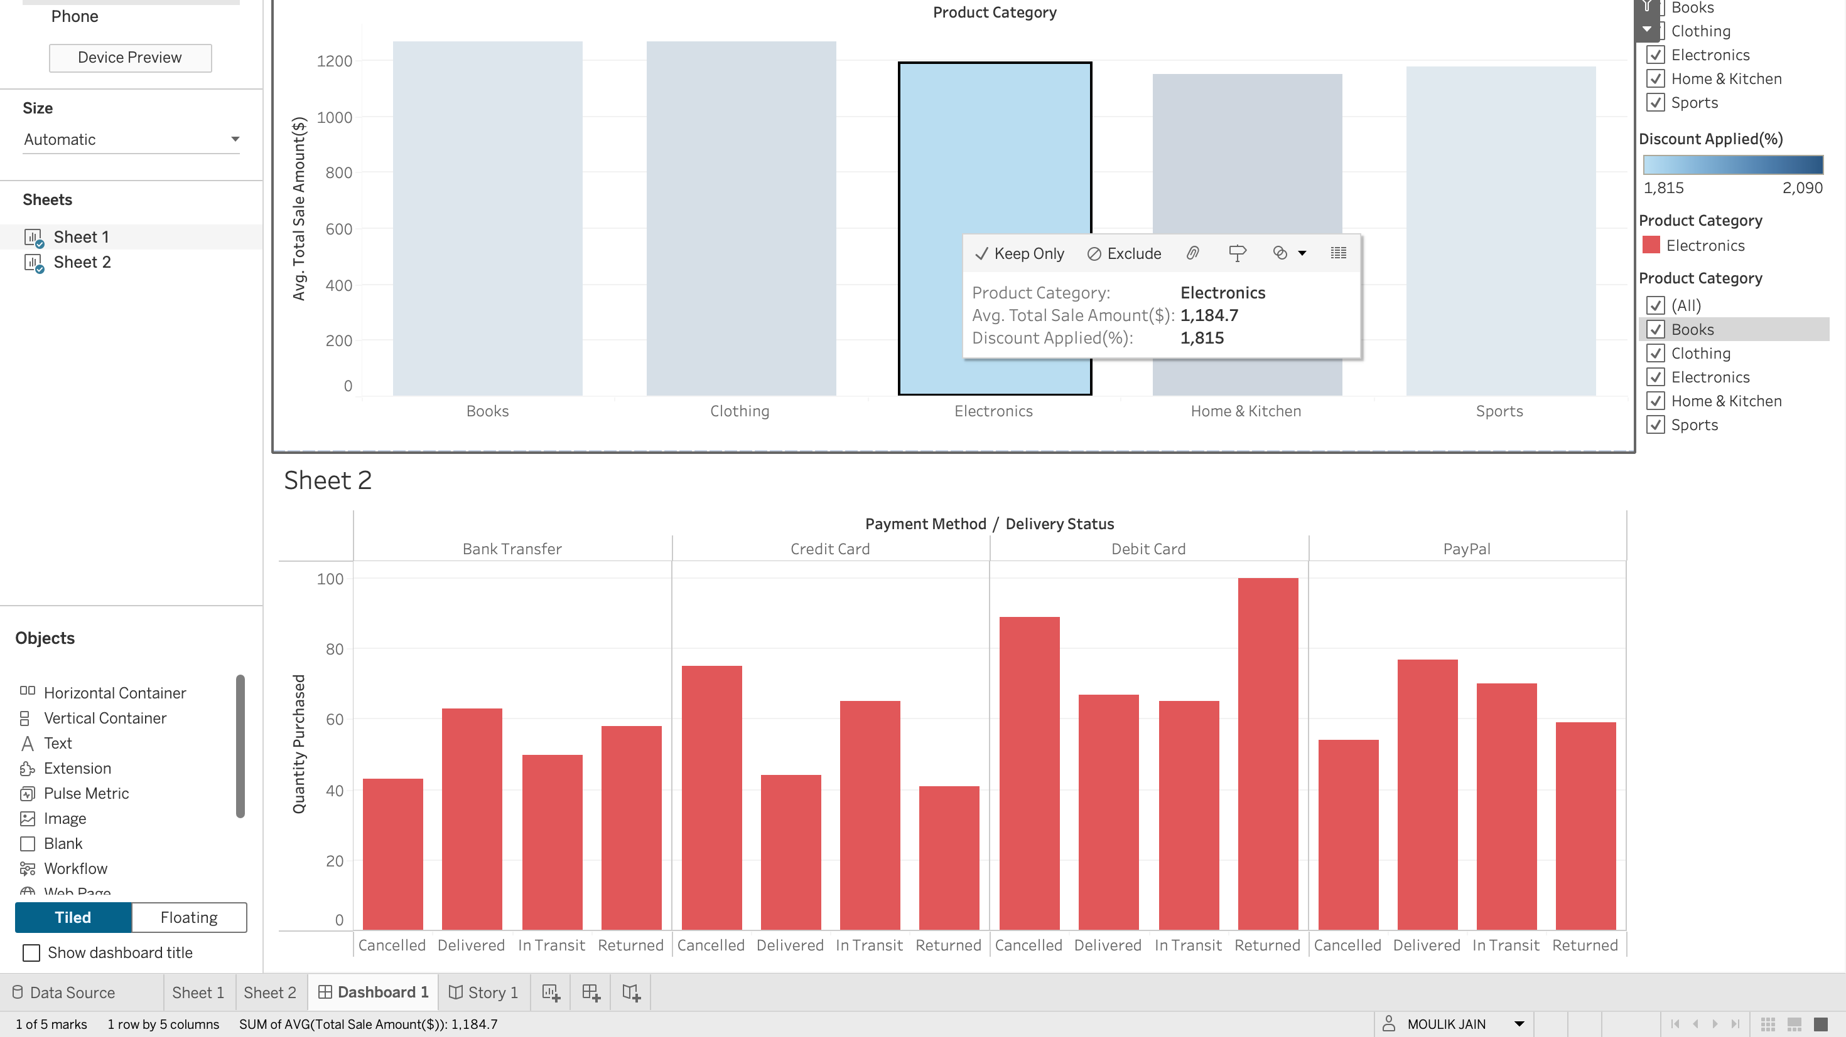
Here, you can see that Electronics Product Category is selected in Sheet1 and it only displays the values of the same Product Category in Sheet 2, meaning, the Dashboard Action is working.

Slide 14

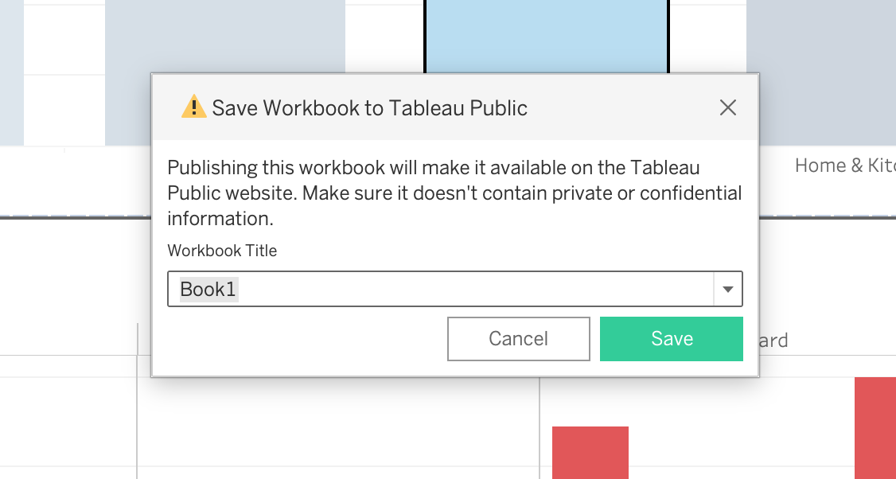
Step 7: Publish to Tableau Public
Publish and Share Your Dashboard
Click File → Save to Tableau Public
Sign in to your Tableau Public account
Add a title and description
Click Save
Copy the public URL to share
Reminder: All Tableau Public dashboards are publicly visible.

Slide 15
Troubleshooting Common Issues
Data not loading: Check file format and field types
1
Chart looks incorrect: Verify dimensions vs. measures
2
Filters not working: Confirm action settings
3
Dashboard layout breaks: Use containers consistently
4
Slow performance: Reduce marks and filters
5

Slide 16
Glossary of Key Tableau Terms
Dimension – Categorical field (e.g., Category, Region)
Measure – Numeric field (e.g., Sales, Profit)
Worksheet – A single chart or visualization
Dashboard – A collection of worksheets
Filter – Limits data shown
Action – Adds interactivity between views

Slide 17
You’re Ready to Build Interactive Dashboards!
You learned how to:
Connect data
Build charts
Create dashboards
Add interactivity
Publish your work
Practice improves dashboard design
Explore Tableau Public for inspiration

Slide 18
THANKS!!

